Slide 1
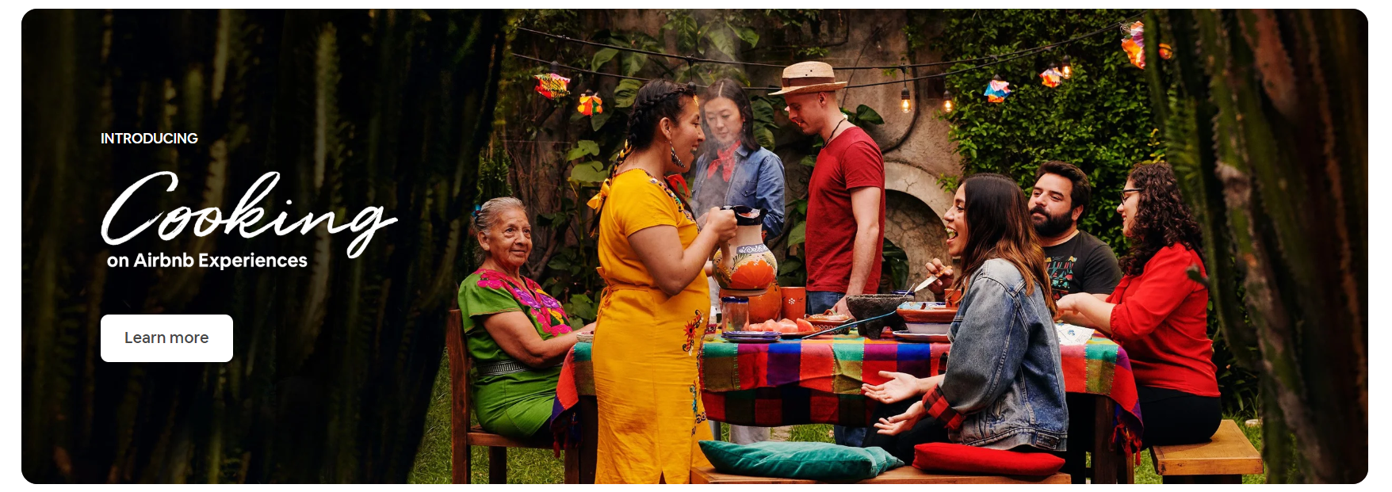
Airbnb Product Analytics Report
Team 4
2019-05-14

Slide 2
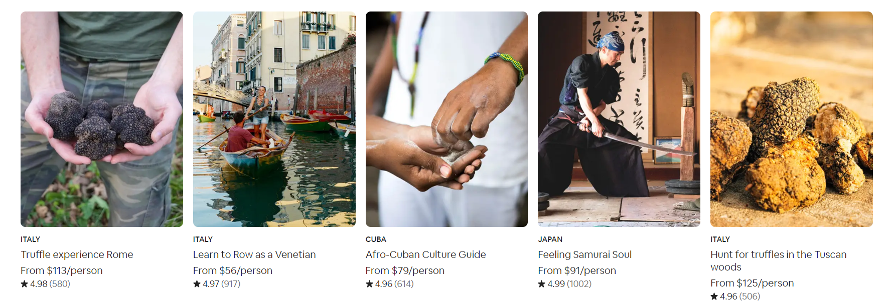
At present, Airbnb is a community platform product with operations in 191 countries and often appears in excellent business analysis cases. Does its business have room for improvement?
For the purpose of analysis, the following three questions are asked:
What characteristics does the target user group of Airbnb have?
What are the current promotion channels of Airbnb, which are not good enough and which need improvement?
Which part of the current conversion rate and churn rate is problematic, or is there room for improvement?

Slide 3

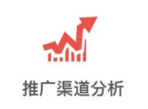

User Portrait Analysis
Promotion Channel Analysis
Funnel Analysis

Slide 4
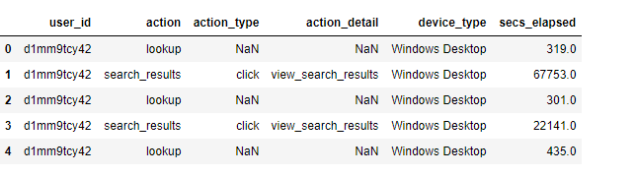
1
Data source and process
Data Name：Airbnb New User Bookings
Data Source：https://www.kaggle.com/c/airbnb-recruiting-new-user-bookings/data
Data Description：In this challenge, you are given a list of users along with their demographics, web session records, and some summary statistics. You are asked to predict which country a new user's first booking destination will be. All the users in this dataset are from the USA.
Data Size：21w * 15（train_user）、104w * 6（sessions）
Data format of Sessions is shown as below：

Slide 5
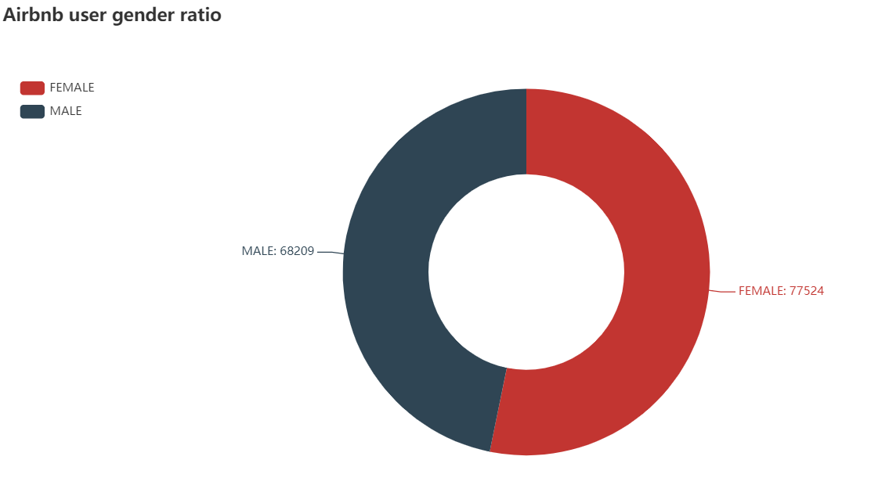
2
Airbnb User Portrait Analysis
Airbnb's male and female user ratio does not have big difference, female users ratio is more than male users ratio: 6.4%

Slide 6
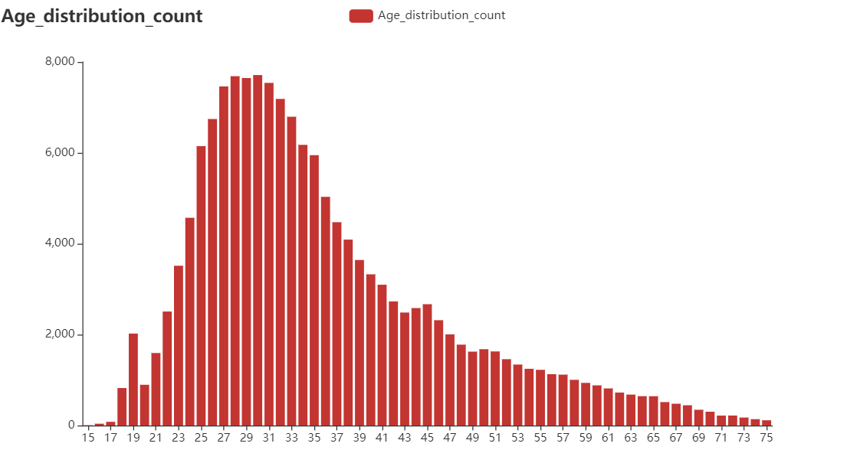
2
Airbnb User Portrait Analysis
the Post-80s
the Post-90s
Airbnb's users are mainly "young and middle-aged groups", among which the largest number of users are the post-80s (29-39 years old), followed by 90s, and then 75s.
the Post-70s

Slide 7
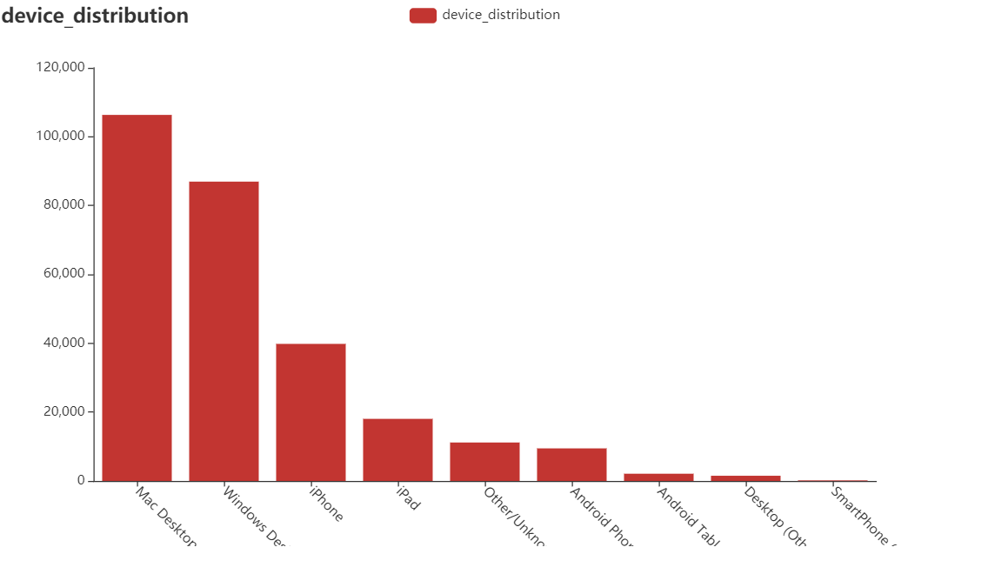
2
Airbnb User Portrait Analysis
More Airbnb users use Mac than those use windows.
More Airbnb users use iPhones and iPads than those use Android.

Slide 8
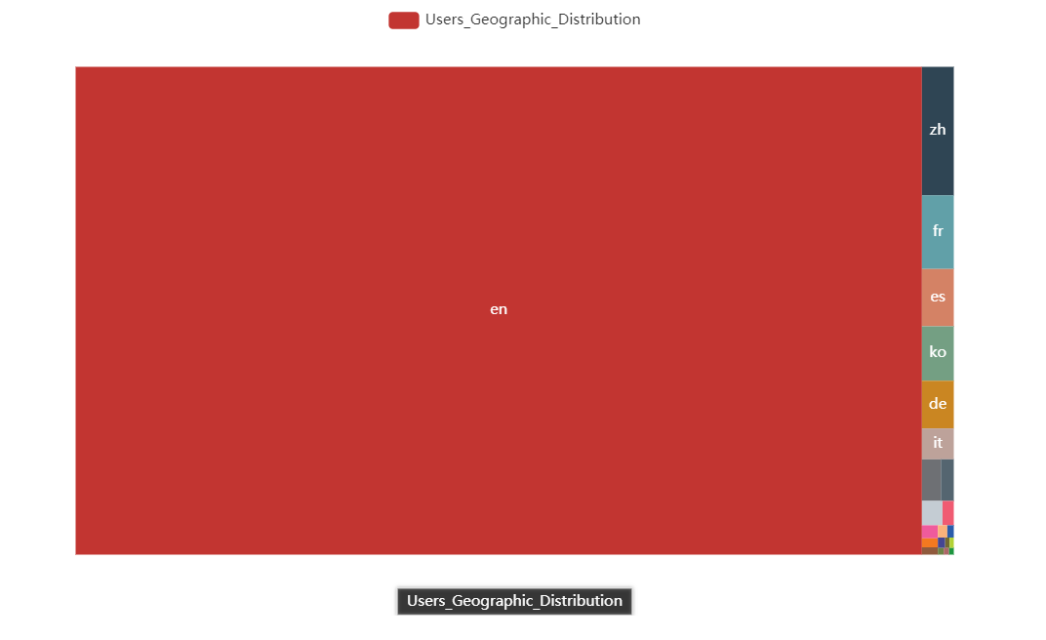
2
Airbnb User Portrait Analysis
Airbnb is really international, with users in multiple regions.
More than 90% of the users are in English-speaking countries (Europe and America); airbnb began to enter the Chinese market in 2013 (this data set ends in 2014), so although the number of Chinese users at this time ranked second, the proportion was very small.

Slide 9
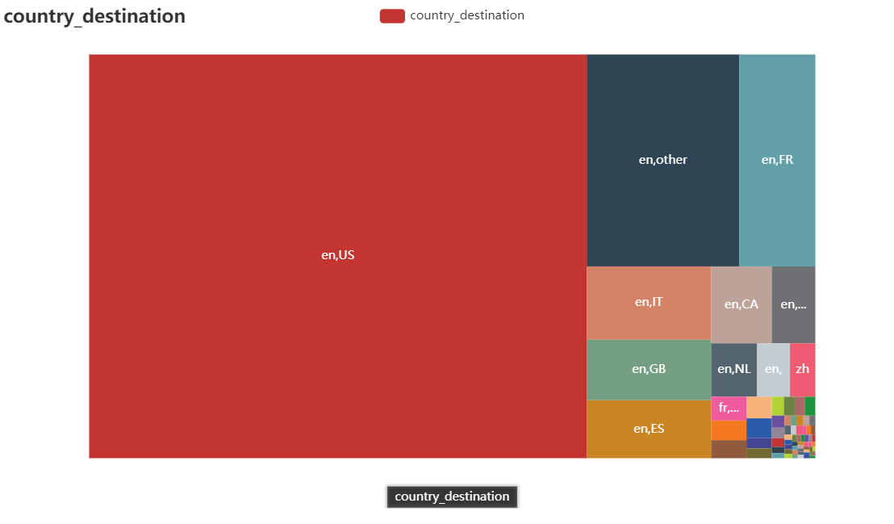
2
Airbnb User Portrait Analysis
After all, Airbnb is still used more by users in Europe and the United States.

Slide 10
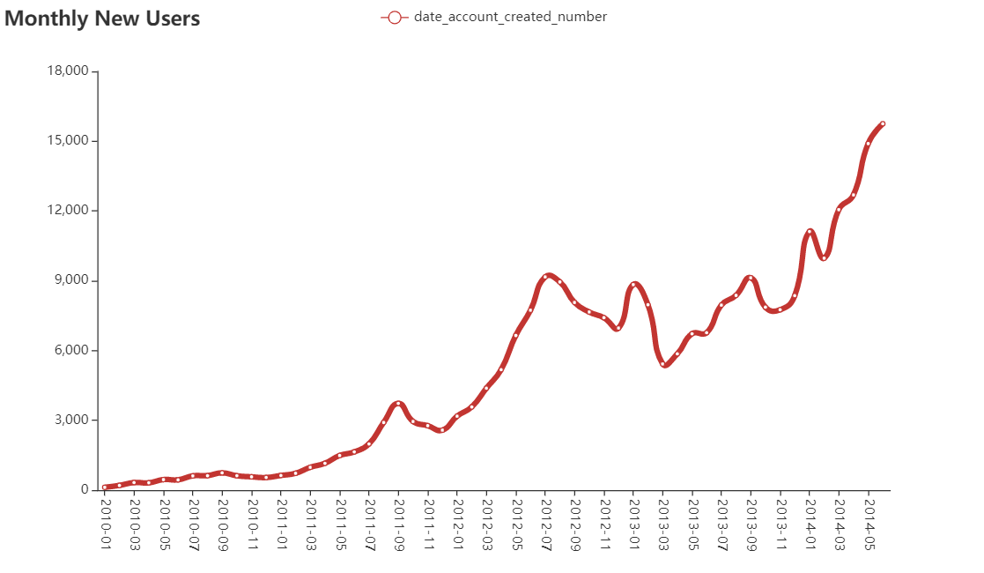
3
Airbnb Promotion Channel Analysis
From the visualization results:
Airbnb's user growth curve is healthy, flat in the early period (before 2011), and began to grow rapidly after February 2012.
After 2012, the growth rate is fast.
The regularity of the increase of new users of Airbnb: from January to July of each year, Airbnb will usher in the peak of user growth. It is considered that summer (Northern Hemisphere) is the peak season of travel, and short-rent products are a type of travel consumption.

Slide 11
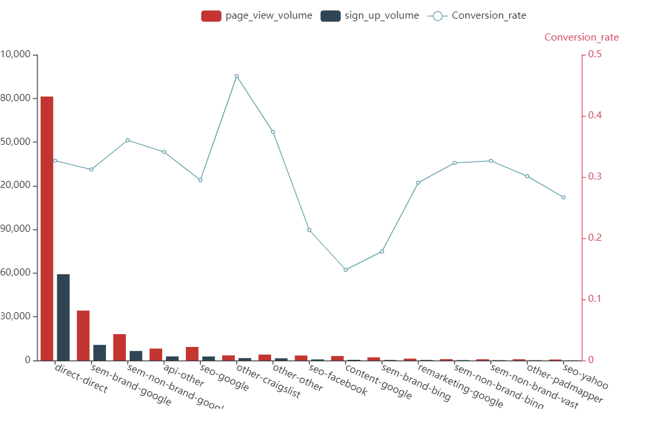
Channel registration volume:
Airbnb ’s overall channel conversion rate is performing well, with most channels having conversion rates above 30%.
Google Auctions (SEM) performed the best, where the number of registered brand auctions was greater than the number of non-brand auctions.
The number of channel registrations conforms to the Pareto principle, and the registration volume of the first 7 channels (a total of 40 channels are promoted) has accounted for more than 90% of the total channel sources of Airbnb.
content-google's 14.82% conversion rate is lower than other channels’ conversion rate.
3
Airbnb Promotion Channel Analysis
Conversion Rate
Content_google:0.1482090042720999

Slide 12
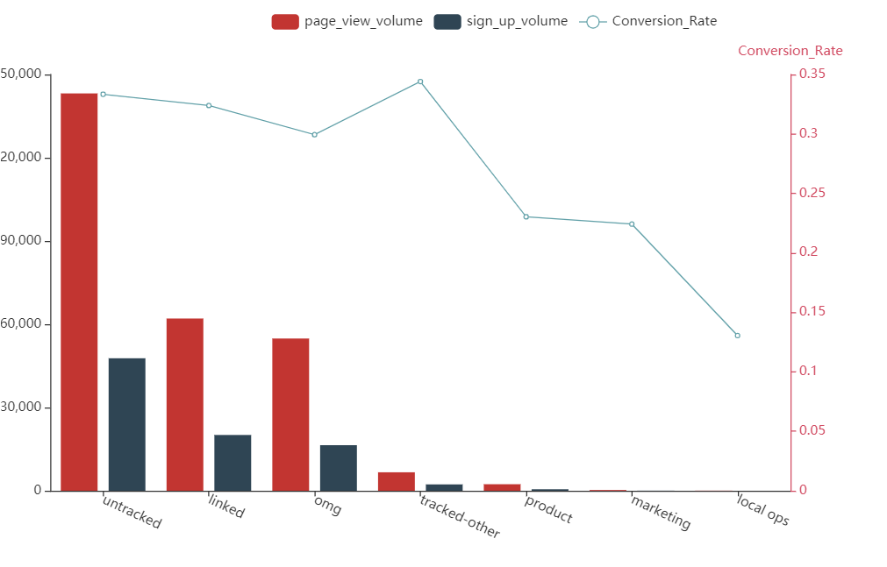
3
Airbnb Promotion Channel Analysis
In terms of marketing content:
The statistical function is abnormal and the data tracking effect is poor.
The conversion rate of linked and omg marketing content is good.
Compared with other marketing content, the conversion rate of local ops is very low.

Slide 13
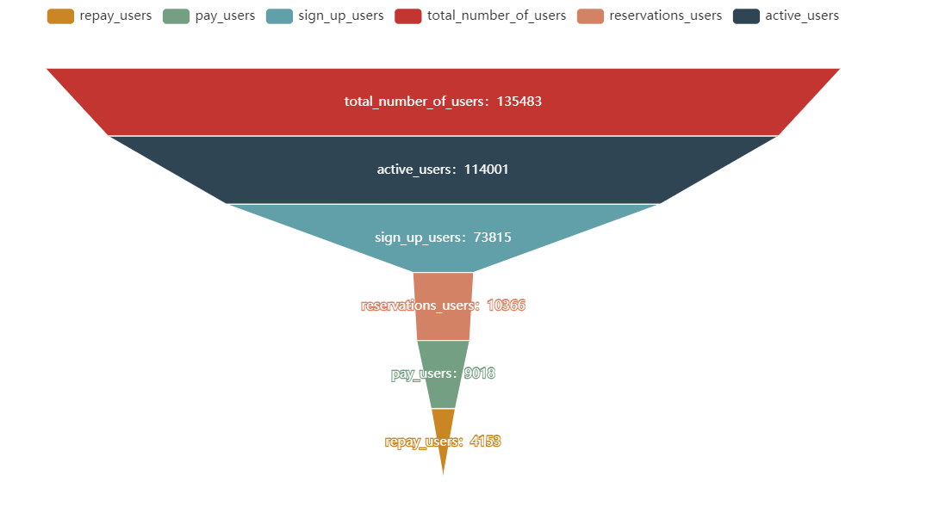
4
Airbnb Funnel Analysis
From the visualization results:
From registered users to order users is the one with the highest turnover rate in the Airbnb conversion funnel. Only 14% of registered users place orders, accounting for only 7.651% of all users.
The active and repurchase performed well. 60% of the users who placed orders repurchase, indicating that Airbnb's services is great.
About 13% of the users who placed the order did not make the final payment, requiring product R & D intervention
The highest conversion rate

Slide 14
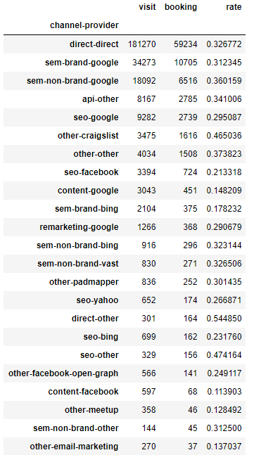
5
Airbnb Product Suggestions
Improvements on promotion channels
From July to October is the peak season of the business. It is recommended that the operating department increase the intensity of marketing in July and October of each year, and increase the channel advertising.
The content_google conversion rate is very low (only 15%) in the main channels (the channels with the top 7 registrations). It is recommended that the operation department calculate the ROI and ARPU (average revenue per customer) for this channel. If the ROI is too low, it is recommended to stop this Channel delivery. ROI = Conversion rate * ARPU value / CPC
The promotion and conversion of all channels under the promotion of SEO are good. As a lower-cost customer acquisition method (mainly labor costs), SEO is recommended to support the management of SEO-related resources on a daily basis, and even consider expanding SEO team.

